Slide 1
Azure Bot and Root Cause Analysis using unsupervised model
Arunava Manna(IFAP CSC FI BE)
28.07.22

Slide 2
Agenda
My Introduction
Unsupervised Modelling For Remedy Incident Tickets
Background of the problem
Data Processing steps using Natural language Processing(NLP)
Machine Learning Model familiarity
Unsupervised Models
LDA(Latent Dirichlet Allocation) technique
TF-IDF Vectorizer
Model Pipeline
Chatbot Dialog Flow concept for Printing Service

Slide 3
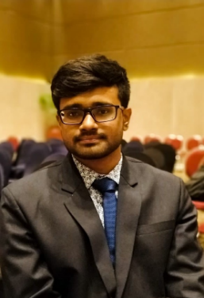
My Introduction
EMPLOYEE PROFILE:
Organization Unit: IFAP CSC FI BE BOC
Position: Pattern recognition and Automation Intern
Date Join: 18th May 2022
Date End: 29th July 2022
Roles & Responsibilities:
Extracting unstructured problem sentence from tickets
Symptom Analysis of Incident Tickets using NLP
Building a chatbot framework for the purpose of deploying the NLP model
Background:
MSc in Electrical Engineering with a major in Information technology
Systems Engineer at Infosys Limited (2019 – 2021)
Bachelor in Electrical Engineering (2019)
Hobbies: cooking, traveling, photography, exploring new technology
Reporting Manager:
Legal: Tan Geok Leng(IFAP CSC FI BE)

Slide 4
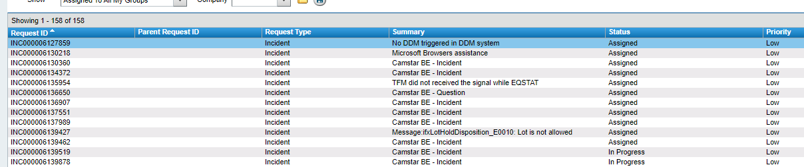
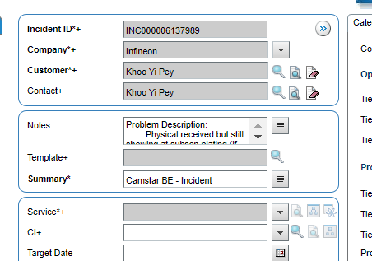
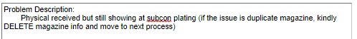
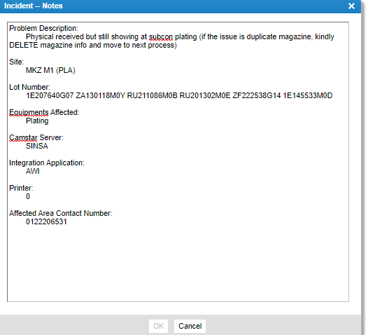

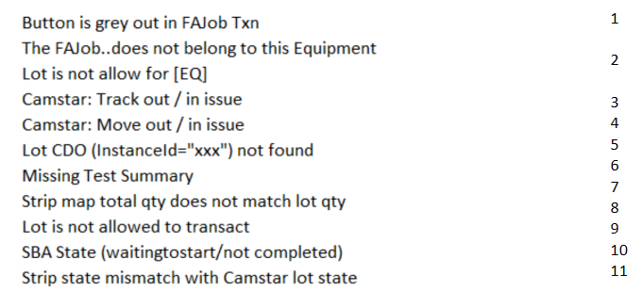

Background of the Problem(Proactive)
Proactive – early detection of symptom without intervention of BOC team
What is the symptom that the problem description is indicating and is there a way to automate the process of identifying the symptom and use it to resolve it automatically?
Symptoms generalized by the BOC teams

Slide 5
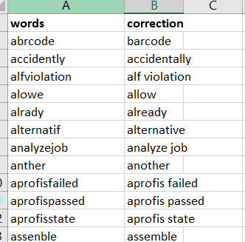
Data Processing Steps
Data Extraction
From raw problem descriptions
Elimination of Special characters
[,\.!?:()/_-] also new line, tab, space
Spell Correction
Misspelled words
Removal of Stop Words
Removal of Non-Dict Words
Final Sentence for the Model
To bring back the base form of words. Specifically, the ed, es, s etc.
Lemmatization
prepositions, interjections, adverbs, pronouns, introductory words
Words like mkz, sin, Infineon, Camstar, site.

Slide 6
Machine Learning Model Familiarity
Algorithm which can learn or adapt something without following any explicit instructions and draw inferences from the patterns of the data. -> ML definition
Machine learning Models
Supervised
Unsupervised
Reinforcement learning
Target label available for the model to learn from
Model learns by evaluating the data pattern
Learn from environment on the basis of rewarding strategy
Require human intervention to label the data
Require human intervention for validating output
Standard agents require constant monitoring of human to decide on when to intervene
Statements
Explanation
For example:
Consider a exam scenario.
Students are attending the exam after preparing for it.
Categorizing students in different performance category based on their grade.
Teaching students who did bad in the exam
Firstly, the students are taking the exam after doing the preparation
supervised technique
Second the teacher is categorizing the students into different classes by clustering them into different score groups by measuring the distance between their grades. Unsupervised technique
Third the teacher will ask the bad performing students to appearing for exam again and if they score well then they will be rewarded otherwise there will be penalty in their score. Reinforcement learning

Slide 7
Model exploration in regard to the Remedy Incident Ticket
Our goal is to extract the symptoms from incident tickets
Supervised Model | Unsupervised Model
Supervised models require human to label the data. Labelling engages BOC team to assign a particular symptom to each sentence. This makes the task difficult and some of the sentences can’t be easily interpretable. For example: LSTM model which provides good accuracy during training but not during test. | Use only data to find the pattern in between them by clustering or association technique. In our case we explored the topic modelling techniques. This technique clusters the words using probabilistic LDA approach. Moreover, it calculates the distance in between the words of same sentence and distance between words of other sentences

Slide 8
Unsupervised Models
Unsupervised Models that I tried so far:
BERTTopic
A pretrained model from HUGGINGFACE
Gensim LDA
The algorithm depends on the LDA technique
SklearnLDA
Uses LDA technique from sklearn
SklearnNMF
ClusterTransformer
Similar to LDA but uses truncated SVD technique
An unsupervised model depends on other pretrained models.
Not able to cluster sentences properly and the topics are not understandable. Since this pretrained model is trained on Wikipedia data.
The topics are not that relevant to what we expected
Giving decent result. But further hyperparameter tuning is required
Final Model
Providing good topics but predictions on the sentences are not accurate
Uses a lot of resource to process the data.
Didn’t get to explore much due to time constraint

Slide 9
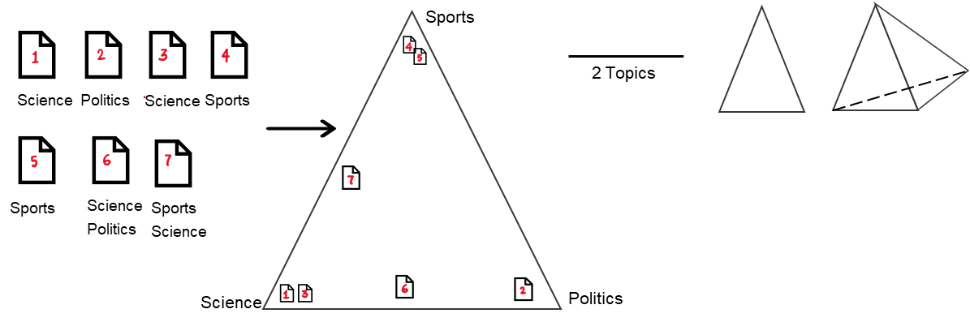
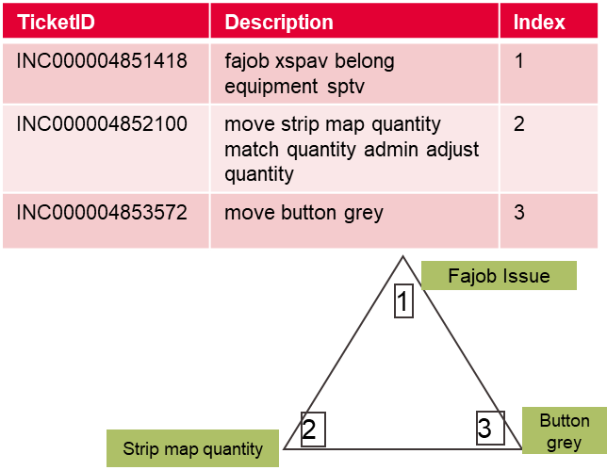
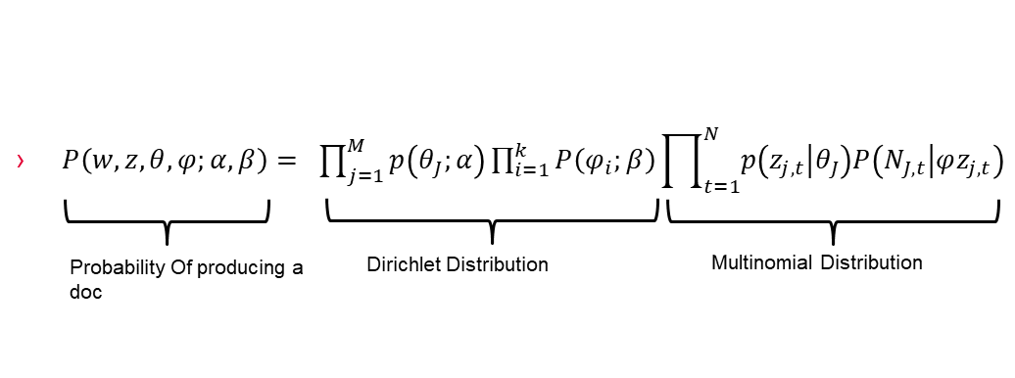
Latent Dirichlet Allocation(LDA) For Topic Modelling
3 Topics
4 Topics

Slide 10
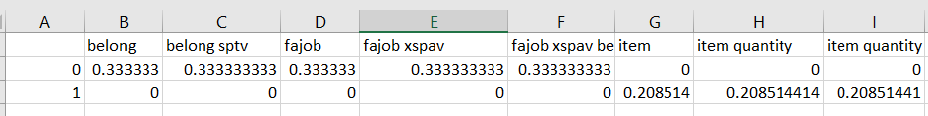
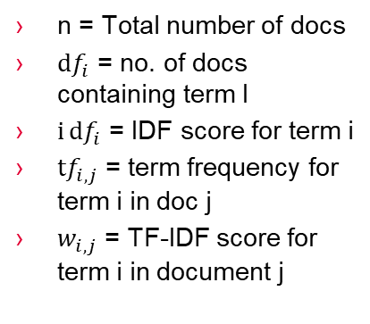
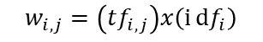
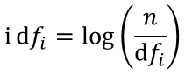
Term Frequency – Inverse Document Frequency(TF-IDF)
Text -> usable vector (Text vectorizer)
Term Frequency( no. of occurrences of a specific term in a doc)
Document Frequency(no. of documents containing a specific term)
IDF(weight of a term, it aims to reduce the weight of a term if the term’s occurrences are scattered throughout all the documents)
$$ⅈⅆf_{i}=\log\left(\frac{n}{ⅆf_{i}}\right)$$
n = Total number of docs
$ⅆf_{i}$ = no. of docs containing term I
$iⅆf_{i}$ = IDF score for term i
$tf_{i,j}$ = term frequency for term i in doc j
$w_{i,j}$ = TF-IDF score for term i in document j
Here, n-gram range = (1,3)
$$w_{i,j}=\left(tf_{i,j}\right)x\left(ⅈⅆf_{i}\right)$$
Note: N-grams are continuous sequences of words or symbols or tokens in a document. In technical terms, they can be defined as the neighbouring sequences of items in a document.

Slide 11



Model Pipeline
Raw Data
Data Preprocessing.py
Processed Data submission
Main_<lda/nmf>.py
sklearnLDA.py
Model
Submission
What it contains?
TF-IDF vectorizer
Train the processed data with Sklearn LDA model
Processed data for training purpose
Along with the topics
Test_lda.py
sklearnLDA_test.py
Test prediction
Uses the trained model for testing purpose

Slide 12
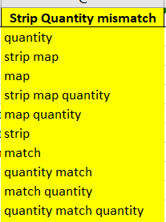
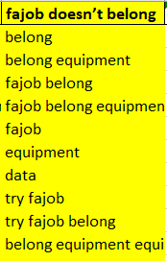
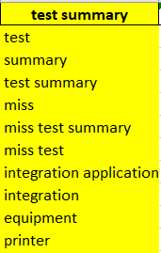
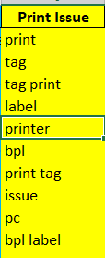
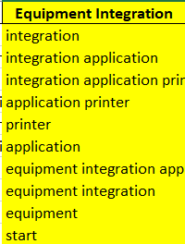
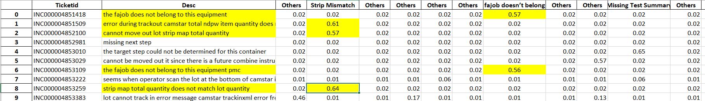
SklearnLDA output
First output : 5 Topics identifiable
Second Output: Topic Confidence Score on each sentence
Cluster of words belonging to a particular symptom

Slide 13

BOC Chatbot for Incident Ticket using unsupervised NLP model
What is the Purpose
To leverage the model built for the symptom analysis and resolution of incident tickets automatically
What Type of chatbot
Microsoft Azure with python SDK
Process
It requires the knowledge of Asynchronous programming
The app layer is available with the azure sample bots
The bot layer requires user to write program for different dialogs for different purposes. My bot currently has two dialogs. One for the introduction and symptom analysis and other one is for the resolution of only “print” type of Symptoms.

Slide 14
Chatbot Dialog Flow concept for the printing issue
Frontend
Backend
User can interact with a BOC member
Problem
LDA Model
Symptom
Yes
Other
If yes
Printer Name
Stored
Computer Name
Stored
Ask User to check LAN cable with some sample pics
If yes
Bot will check the ipaddress
Ask user to contact IT team
Yes
No
Ask User if there is any red light
If No
Configuration check
Yes
No
Status Table
Cartrige status
Queue status

Slide 15
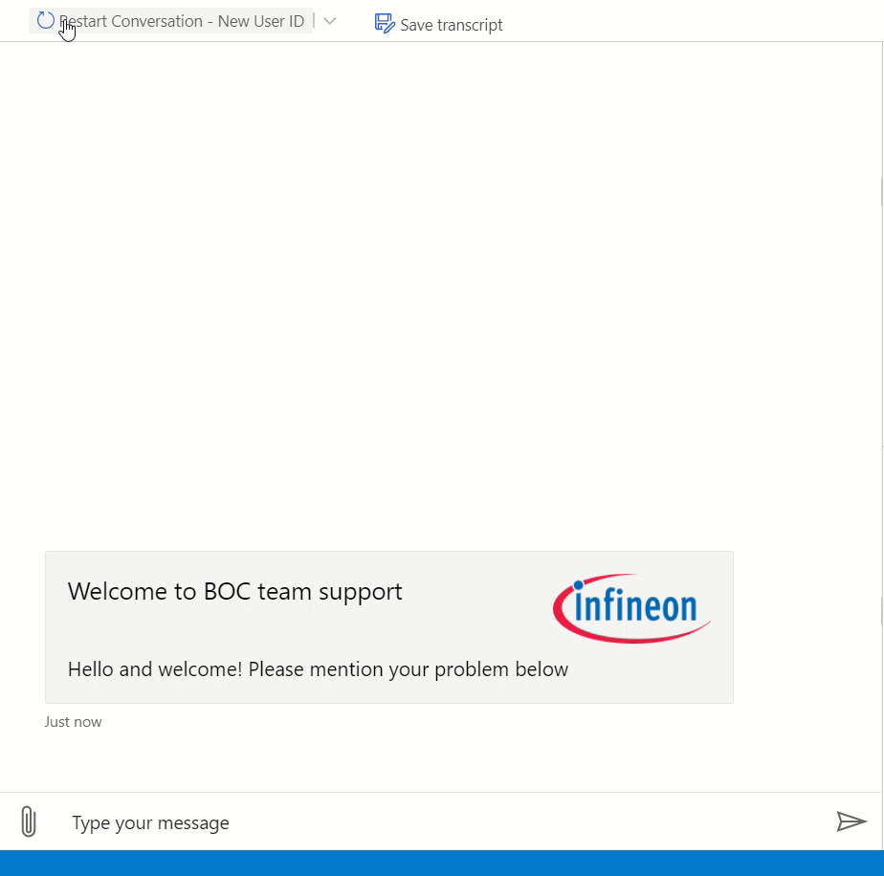
Chatbot Sample
As the recording shows at the end of evaluation Into different problem areas, it will show the status of each are along with the FAQ document.

Slide 16

Challenges
Data Extraction from the Noisy data
Not all symptoms are interpretable
The training takes a long time. To overcome that a library named “ray” has been used to share the load among all the cores of CPU.
Calculating accuracy is very difficult since it requires human intervention
The most difficult task was to choose the topics based on different state of data and combination of hyperparameters

Slide 17

Takeaway
Networking with other colleagues
Knowledge gain on different Natural language Processing(NLP) concepts
Skills on the way of thinking a workflow for solving a problem
Incredible working experience with Factory Integration team
Also, I would like to express my heartful thanks to Geok Leng and her team for giving me the opportunity and supporting me throughout the internship period.

Slide 18
Thank You

